Slide 1
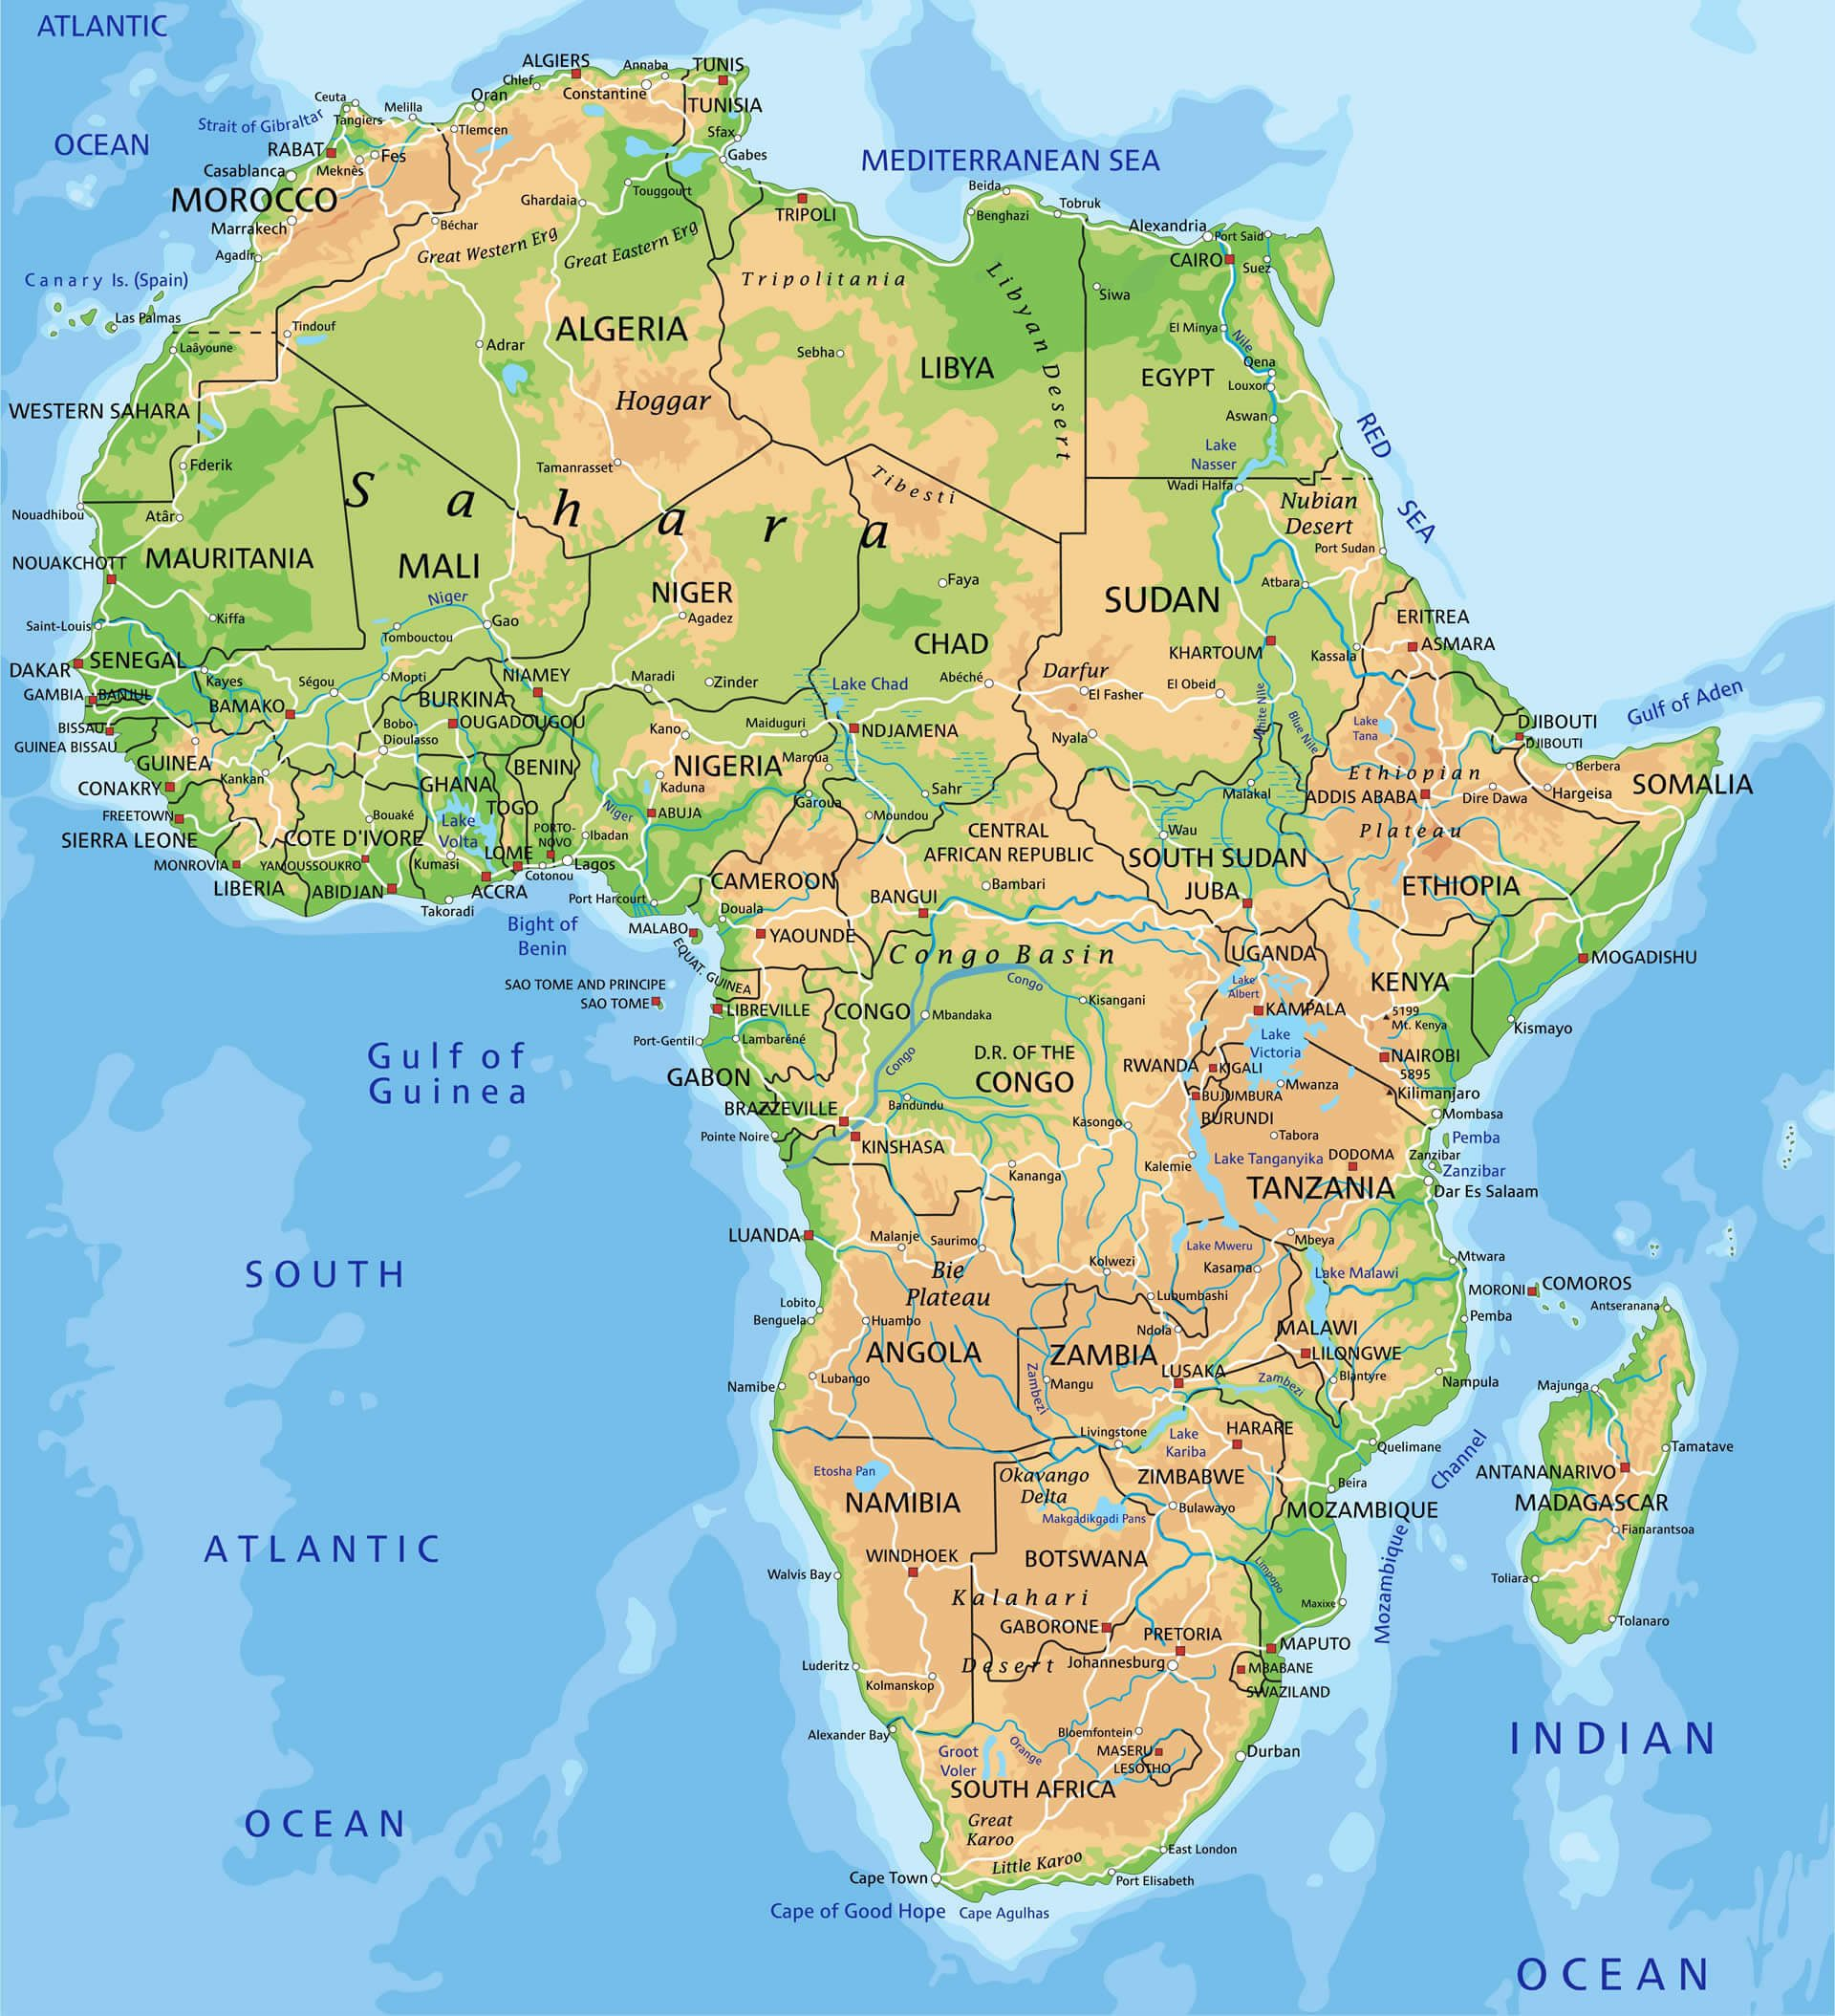
Modeling the Impact of Rapid Containment on Ebola Outbreaks
Jason Hunter

Slide 2
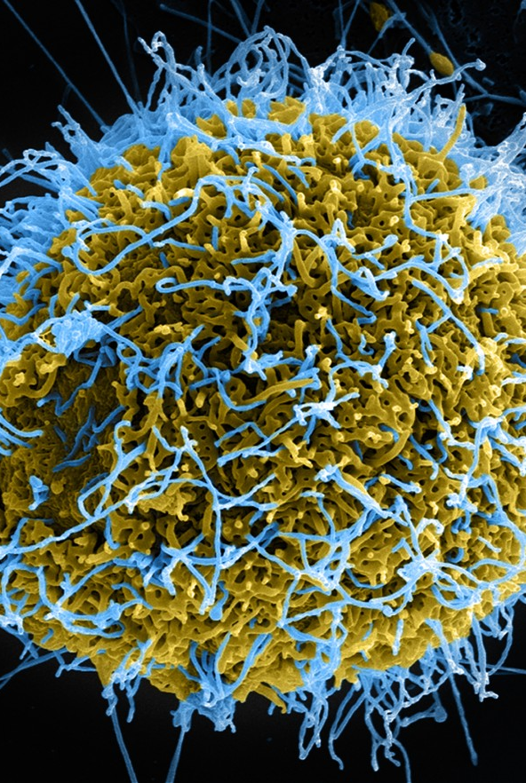
What is Ebola?
Ebola is a rare, deadly, and highly contagious viral infection that has caused severe outbreaks.
The virus is mostly prevalent in Central and Western regions of Africa.
Ebola is a zoonotic disease that scientists believe originally spread from fruit bats.
The virus is spread via direct contact with bodily fluids of infected people, as well as contact with contaminated surfaces.
Ebola causes flu-like symptoms and internal hemorrhaging.
Key Challenges Ebola Poses:
Ebola has a very high mortality rate (~50%)
Ebola poses the risk of widespread epidemics.

Slide 3
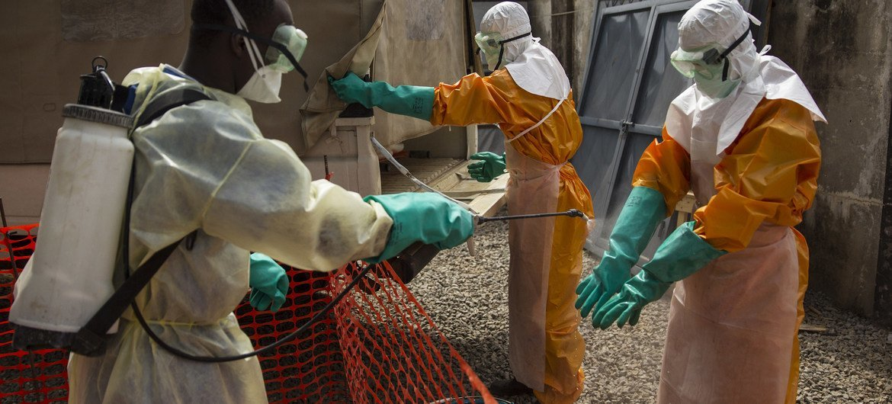
Research Question
The core question that I want to focus my research on is the following:
How can rapid containment and medical intervention reduce the severity of an Ebola outbreak?
In doing so, I plan to develop an Ebola transmission model, which I will use to assess how the timeliness of intervention and treatment can affect the spread of the virus.

Slide 4
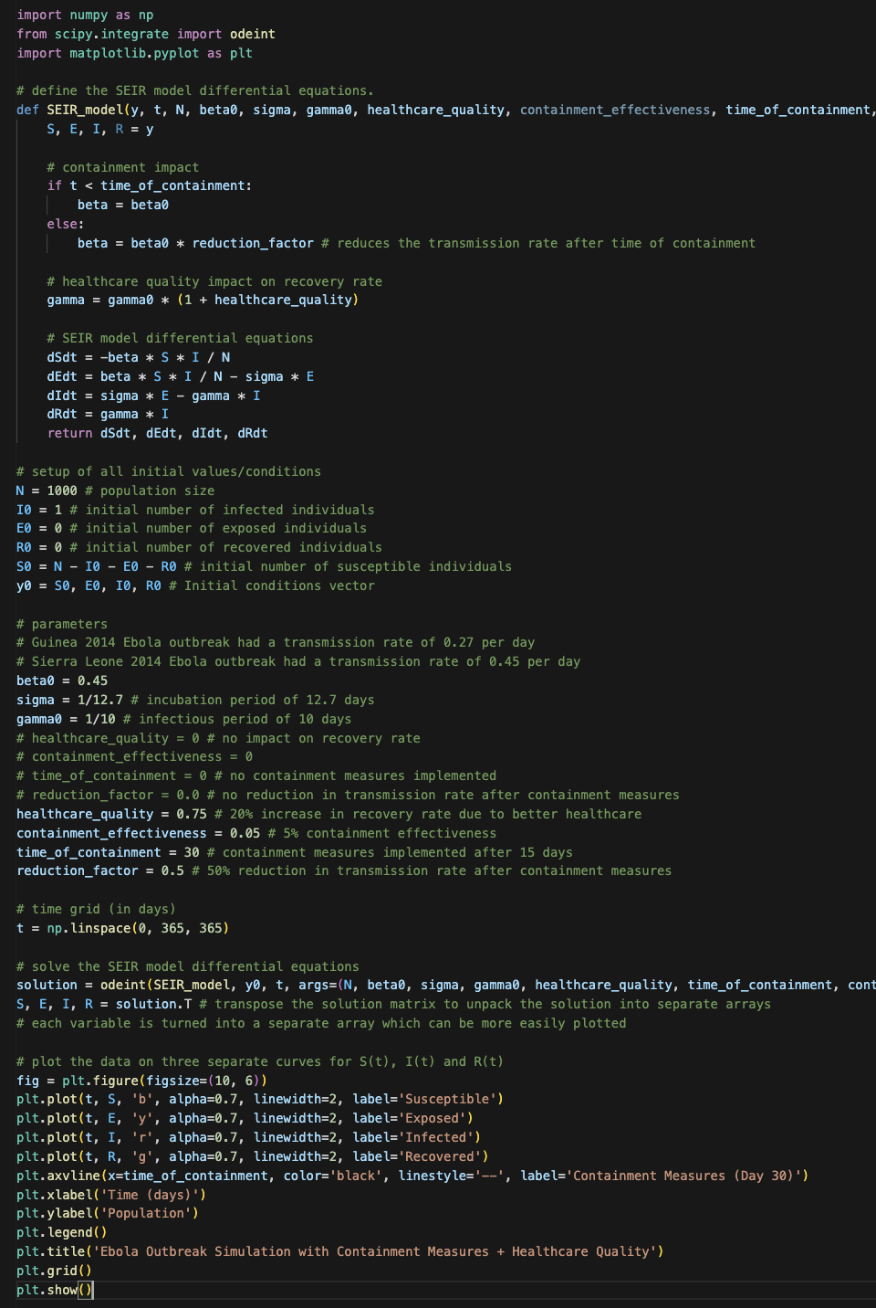
Modeling Approach
I think its best to use an SEIR (Susceptible, Exposed, Infectious, Recovered) model for Ebola, so that I can account for the latent period in which a person is exposed, but not yet infectious. The latency period for Ebola can range from 2–21 post-exposure, but 8—10 days is most common, therefore its important to consider this when modeling.
Parameters:
Population Size
Transmission Rate
Recovery & Mortality Rates
Speed of Containment (in days)
Latent Period

Slide 5
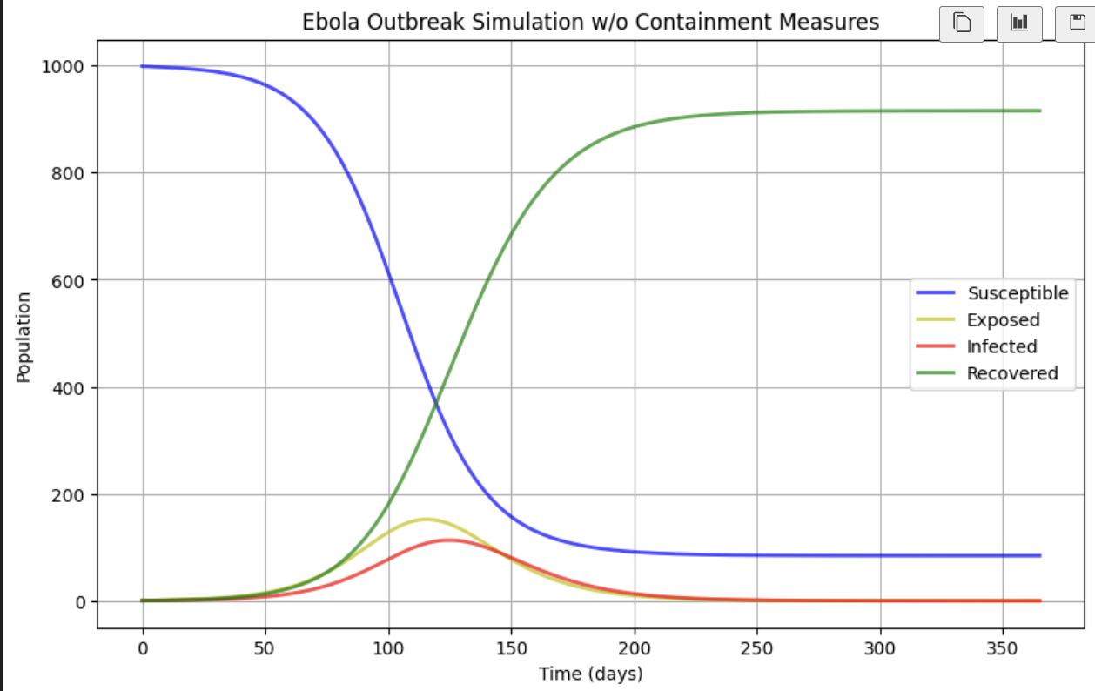
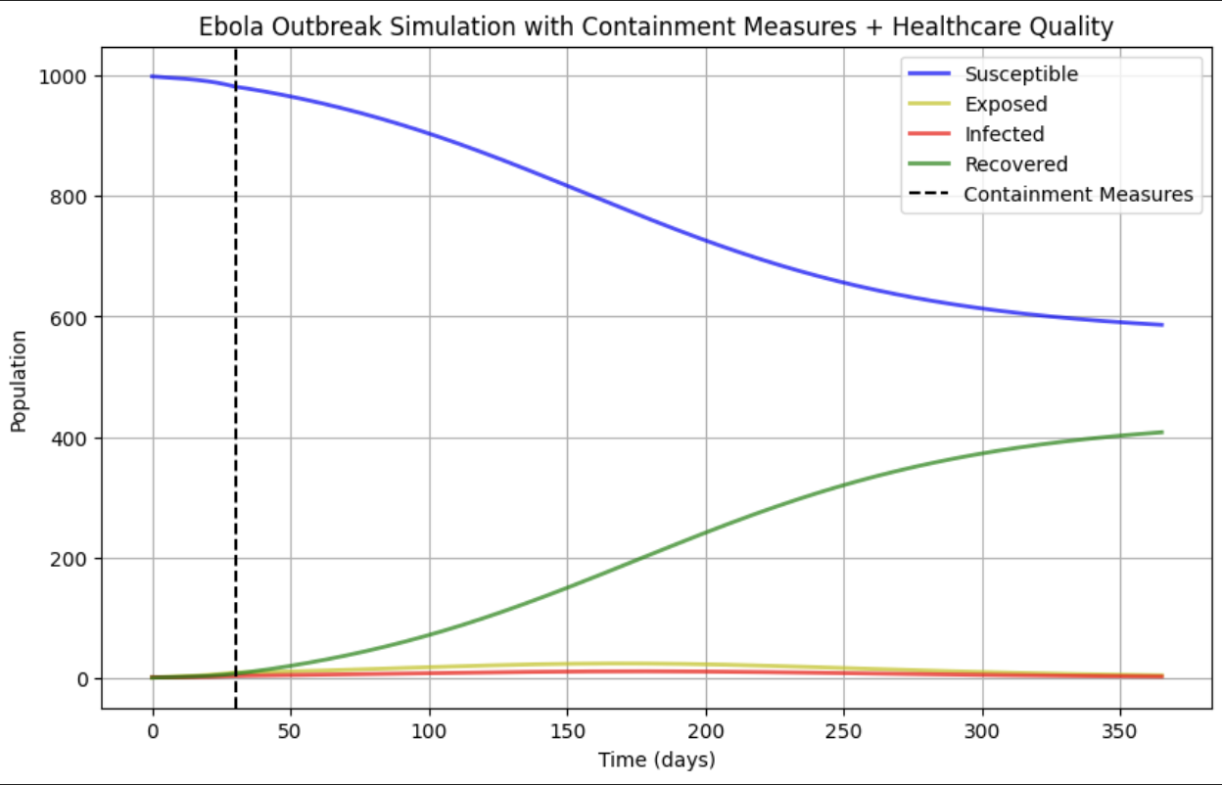
Results
Using an SEIR model, I’ll look at the infection peaks both with and without intervention.
This will help me identify the impact of early vs. delayed intervention on the spread of an Ebola outbreak.
I also am interested in the quality/effectiveness of available healthcare and its associated capacity on the severity of an outbreak.

Slide 6
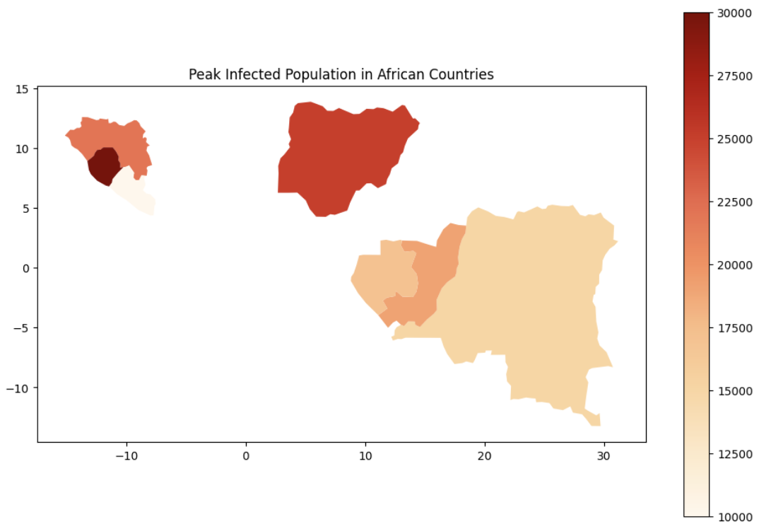
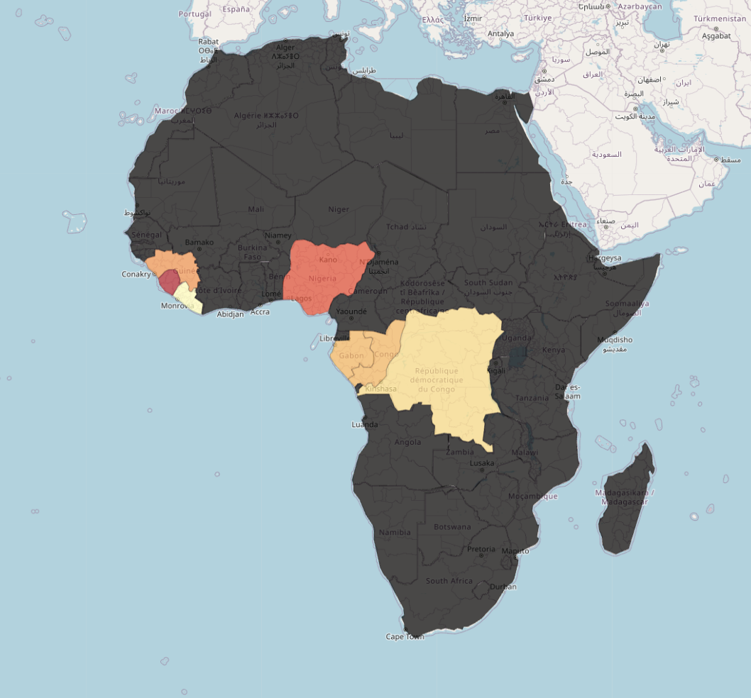
Challenges
Some of the difficulties that I’m finding in creating this specific model, include:
Calibrating the parameters of the model to Ebola specific dynamics.
Data availability for regional healthcare capacity and intervention timings seems difficult to obtain, especially for more rural areas.
How do I model healthcare quality across multiple regions?
How can I model the spread from infected bodies that are diseased?

Slide 7
Moving Forward
I plan to further parametrize my SEIR model development using Jupyter/Python notebook.
Then I’ll run various simulations of different containment strategies such as:
Rapid vs Delayed Containment
High vs Low Quality Healthcare Resource Availability
I also plan to use the folium library and GeoPandas to create better visualizations of the outbreak spread.
Any suggestions or feedback on how I could refine my model is much appreciated!
Questions!?!?

